Slide 1
Training Action: Water reuse and
Sludge management platforms (tools #16 & #19)
Thursday, June 27th, 2024
Patrizia Ragazzo (Veritas)
Davide Storelli (ENG)
Andrea Vedruccio (ENG)
b-watersmart.eu

Slide 2


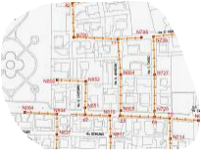
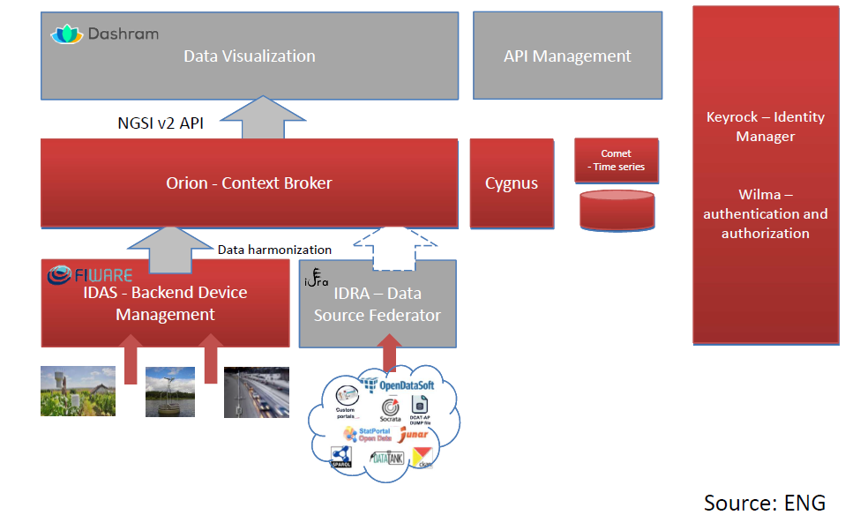
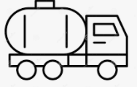
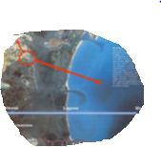
THE STRATEGIC TOOLS - DIGITAL SOLUTIONS - WHY
Clarifying risks linked to resource recovery practices to avoid prejudices
Building a shared, updatable, scientific knowledge base
Solution # 16
Data-information-requirements
Technologies for ranking WATER REUSE OPPORTUNITIES
Identifying the most sustainable-suitable opportunities of reuse/valorisation
N₂ N₂O
Influent
Wastewater treatments
Effluent
Sewage System
Waste Active Sludge
biogas
guarantee repeatability of evaluation processes
AD
Return Liquid Digestate
Sea
Sludge Disposal
Solution # 19
Data-information-requirements
Technologies for guide
SLUDGE MANAGEMENT
Fostering fairer policies and laws revision towards resource recovery practices, with clear directions and without ambiguities
Keeping up to date by maintaining a participatory model of governance (the CoP)
Pre-hydrolysys
Anaerobic Digestion
Composting
Chem.Treat.(CaO+H₂SO₄)
Pirolysis
…
AGRICULTURE
INCINERATION
CEMENT factory
LANDFILL
…

Slide 3
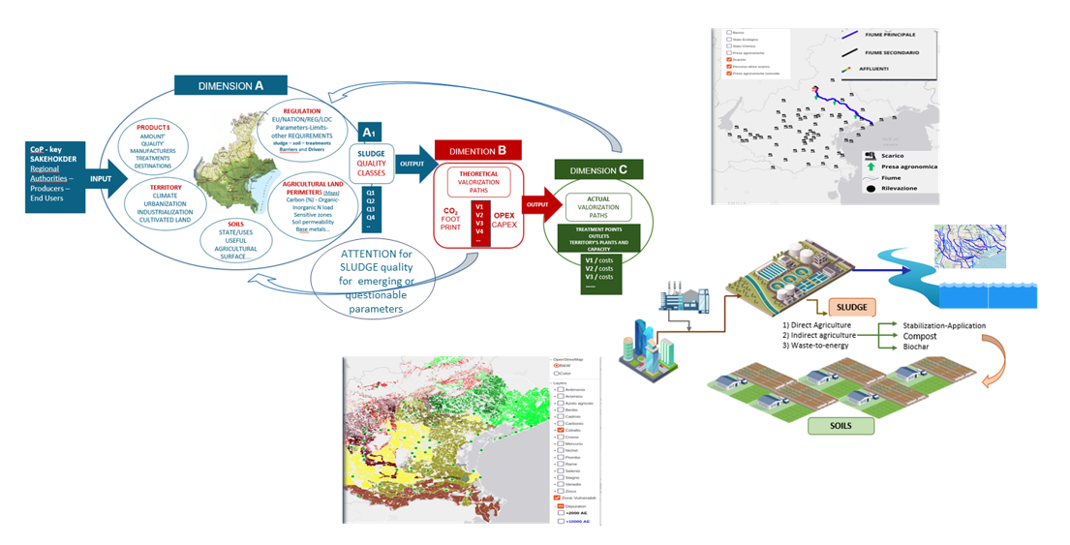
MATCH MAPS OF PRODUCTS AND TERRITORY
P1 - TERRITORY and UTILITIES ANAGRAPHIC
all production points territorial allocation,
match among them and territory for several assesment
P2 - REGULATORY STATUS - EU-NATIONAL-REGIONAL LOCAL - studied and organised by order of importance to identify barriers and potential relationships with resource valorisation (effluents and sludge)
– ACTIONS ON MARKET - SOCIETY
P3 - QUALITY & TREATMENT CHAINS
P3 - TREATMENT CHAIN & CFP
(in terms of range)

Slide 4
P1 - MASTER DATA - FOR AGRICULTURAL EFFLUENT REUSE
MATCH: EFFLUENT AND HYDROGRAPHIC NETWORK
EFFLUENT DISCHARGE & AGRICULTURAL WITHDRAWALS
VOLUMES DISCHARGED & VOLUMES WITHDRAWN
VOLUMES AVAILABLE
SEVERAL SCALE: REGIONAL - BASINS - UTILITIES
 | SEVERAL METRICS TO ASSESS
 | Ensuring water for all relevant uses
 | S.O.A
A1.1 | EXPLOITATION index
A2.1 | Withdrawal % agriculture (dorught)
A3.1 | Effluents indirect contribution to agricultural withdrawals (drought)
A3.2 | Effluents indirect contribution to agricultural withdrawals (normal)
A4.1 | Effluent lost for valorization (sea or lagoon direct discharge)
A5.1 | Effluents compliance with agricultural reuse
A6.1 | Freshwater compliance with agricultural reuse
 | Safeguarding ecosystems and their services to society
 | S.O.B
B1.1 | Effluents contributions to minimum vital flow
B1.2 | Effluents contributions to minimum vital flow

Slide 5
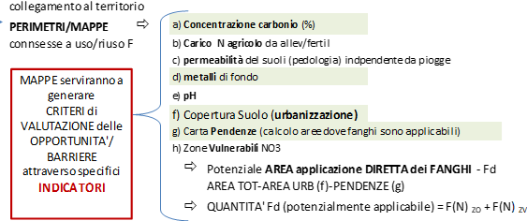
P1 - MASTER DATA - FOR SLUDGE VALORIZATIONS
 | Safeguarding ecosystems and their services to society
 | S.O.B
B2.2 | Avoidable CF (sludge)
B2.5 | Avoided CF (sludge)
B3.1 | Organic carbon available from sludge
B3.3 | Portion of soils with less than 1% of Corg potentially benefitted by sludge per year
B4.1 | maximum acceptability of sludge in the soil - N based
B4.2 | Sludge valorization index - N based
 | Boosting value creation around water
 | S.O.C
C1.1 | Sludge Agriculture Potential
C1.3 | Sludge agricultural valorization
C2.1 | Sludge energy potential
C2.3 | Sludge energy valorization
C3.1 | Fertilizer Production Avoided (N-based)-SLUDGE
C4.1 | Fertilizer Production Avoidable (N-based)-STRIPPING potential
C6.1 | Specific sludge production as it is
MATCH: SLUDGE AND TERRITORY
SLUDGE DIRECT/INDIRECT QUALITY CHARACTERISTICS
MAPS of OPPORTUNITIES – SOIL ACCEPTABILITY
SOIL CARBON CONTENT, ADMISSIBLE NITROGEN LOADS, METALS
SEVERAL SCALE: REGIONAL - BASINS - UTILITIES

Slide 6
P2 – REGULATROY STATUS - MAPS and CONNECTIONS: BARRIERS-DRIVERS
SLUDGE IN AGRICULTURE
EFFLUENT REUSE

Slide 7
MEASURED QUALITY - DIRECT CLASSIFICATION
Lombardy D 6665/2019 - DGRV 235/2009 All.B + L.130/18 - DGRV 235/09 All.C+ L130/18

Slide 8
SLUDGE WORK - THE METHOD
E.P. 7.4M – 5M
QUALITY
Analysed >130,000 Records:
Description
CAS allocation and/or other unique tracking codes
LINEAR CONVERSIONS values in L COMPLIANCE transformation VALUES, INCERTAINTIES and DL expressed on the TQ in DRY SUBSTANCE values (agricultural compliance)
This made it possible to:
CONTRACT numerosity and grouping
noted some CORRECTIONS to be made to the system to make it suitable for systematic mapping
identify RECOMMENDATIONS for MANAGERS and laboratories to ensure less DISPERSION of INFORMATION in the future (which hampers if not prevents discussion and interpretation)
To ensure UPDATE:
a) an application has been created for automatic MANAGEMENT of a certain physiological and ineliminable DIVERSIFICATION of the analytical-quality process, while maintaining the TRACKABILITY of the changes/changes/simplifications made.
COMPLIANCE was measured in relation to direct and indirect AGRICULTURAL application with reference to the three-year period 2020-2022 and using the very RESTRICTIVE REGULATIONS for scrupulousness
Lombardy DGR 6665/19
DGRV 235/09 All.C (and L130/18) regulating the quality of sludge entering the COMPOSTING process.

Slide 9
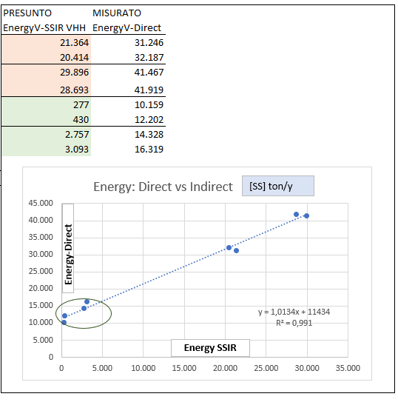
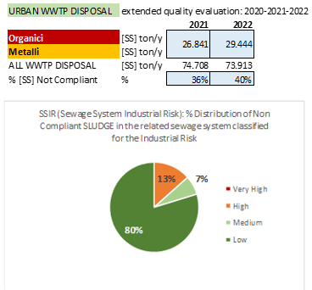
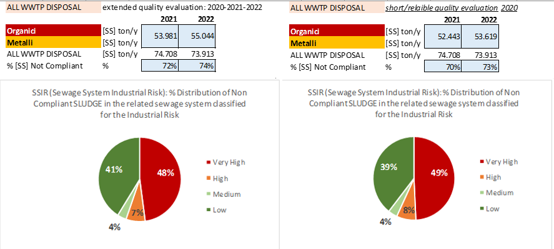
SLUDGE WORK - THE METHOD
MEASURED AND ASSUMED
SSIR MAP: INDUSTRIAL RISK MAP IN THE SEWERAGE SYSTEM
MEASURED
RISKS IN THE SEWAGE SYSTEM
NC a: Lombardy D 6665/2019 - DGRV 235/2009 All.B + L.130/18 - DGRV 235/09 All.C+ L130/18

Slide 10
SLUDGE WORK - THE METHOD

